Slide 1
50 STATES OF DISMAY:
THE EFFECT OF ABORTION BANS ON FOSTER CARE ENTRIES
Correlation One DS4A/Women
Supreme (Court Took Away Our Rights) Team
Priya Balaji, Cassie Berns, Chevaunne Edwards, Sasha Gryshchenko, Paula Wu, Ange Yang
Notes:
Cassie: saying hello, the title of our project & what’s it for

Slide 2






Team 27
Sasha Gryshchenko
Chevaunne Edwards
Priya Balaji
Cassie Berns
Paula Wu
Ange Yang
Notes:
Cassie: introduce the team

Slide 3


Agenda
Background
Research Question
Data Insights
Data Visualization
Statistical Analysis
Model Findings
Conclusions
Notes:
Cassie: outline what we’ll go over in the project (basically the bullet points)

Slide 4

Background
Context
Abortion legalized in 1973
Birth-rates declined 5-8%
Improved living conditions for children
Reduction in number of children relinquished for adoption
The Problem
Roe v. Wade overturned in 2022
Adoption offered as “abortion alternative”
Overburdened foster care system
Notes:
Paula: talk about the background of the project and why it matters (below is a great script for you)
The legalization of abortion in the United States is known to have led to changes in reproductive behavior. Birthrates declined by about 5-8% as a consequence of abortion legalization, with the largest declines occurring among teenagers, women older than 35, unmarried women and nonwhite women. Legalization is associated with an improvement in birth outcomes, such as neonatal mortality. Furthermore, abortion legalization may have led to an improvement in the average living conditions of children, probably by reducing the numbers of youngsters who would have lived in single-parent families, lived in poverty, received welfare and died as infants. Previous research suggests that abortion restrictions less onerous than outright bans reduce the number of infants relinquished for adoption in the United States.

Slide 5

Research Questions
How do restrictive abortion laws impact rates of abortion, foster care entry, and adoption?
What factors influence the rate of entry into foster care?
Notes:
Paula: state the questions we’ll try to answer
The legalization of abortion in the United States is known to have led to changes in reproductive behavior. Birthrates declined by about 5-8% as a consequence of abortion legalization, with the largest declines occurring among teenagers, women older than 35, unmarried women and nonwhite women. Legalization is associated with an improvement in birth outcomes, such as neonatal mortality. Furthermore, abortion legalization may have led to an improvement in the average living conditions of children, probably by reducing the numbers of youngsters who would have lived in single-parent families, lived in poverty, received welfare and died as infants. Previous research suggests that abortion restrictions less onerous than outright bans reduce the number of infants relinquished for adoption in the United States.

Slide 6

Datasets
Abortion Dataset
Incidence of pregnancy, birth and abortion for people of all reproductive ages
Foster Care & Adoptions
Number of children who have entered foster care and/or been adopted
Socioeconomic Factors: Women
Information on employment
Gender wage gap, labor force participation rates for women and men, and percent of workers in managerial or professional occupation
Reproductive rights
Natality
Child care
Cost of children in proportion to income
Notes:
Priya
Sources –
The a leading research and policy organization committed to advancing sexual and reproductive health and rights (SRHR) worldwide.
CDC
Abortion – A publicly available data set of comprehensive historical statistics on the incidence of pregnancy, birth and abortion for people of all reproductive ages in the United States. National statistics cover the period from 1973 to 2017 (dataset comes from Guttmacher Institute)
Foster Care – Annie E. Casey Foundation Kids Count Data Center – Children in Foster Care by Age Group
Socio-economic factors – Institute for Women’s Policy Research

Slide 7

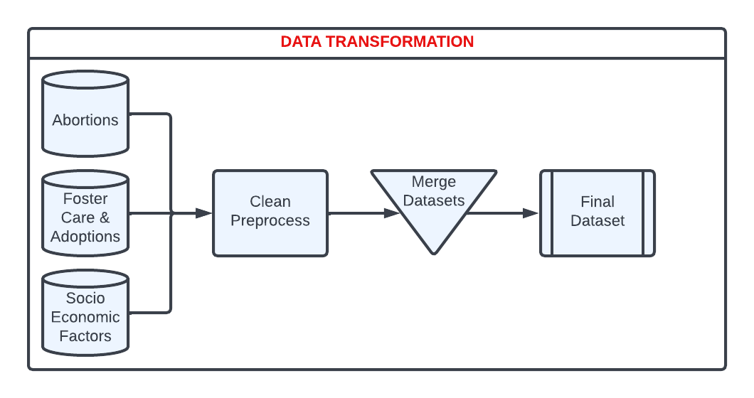
Notes:
Priya
Preprocessing includes
Converting numbers to rates per 1000
Split by political Ideology
Split by levels of restrictive abortions laws
Filtering based on years available

Slide 8
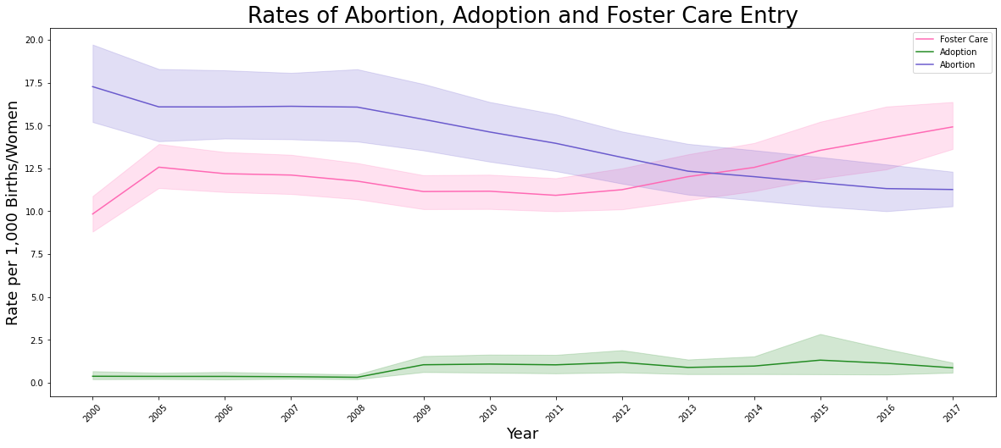
Exploratory Data Analysis
Notes:
Chevaunne
Thanks Priya! So to start, we wanted to look at the rates across the nation of abortion, adoption, and foster care entry and how they intersect. First thing we noticed is that the rate of adoption is far lower than the rate of children entering foster care. We see that adoption rates have increased slightly since 2008, but never comes close to foster care rates.
Second, we see that this interesting drop in abortion that starts happening around the late 2000s, and then a few years later in 2011 there is a marked uptick in children entering foster care, with that rate continuing to increase as abortion decreases overall.

Slide 9
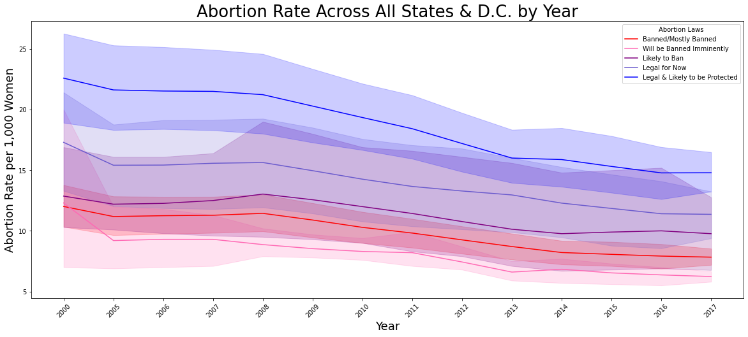
Exploratory Data Analysis
Notes:
Chevaunne
Now we were wanted to group the states by their current abortion ban status and see if the decrease in abortion rates can be attributed to one or more groups. From this run chart, we saw that abortion rates seem to have been decreasing across all groups. BUT, we also see lower rates in the states with more restrictive laws. This made sense to us as decreased access typically leads to decreased opportunity to procure a product or service.

Slide 10
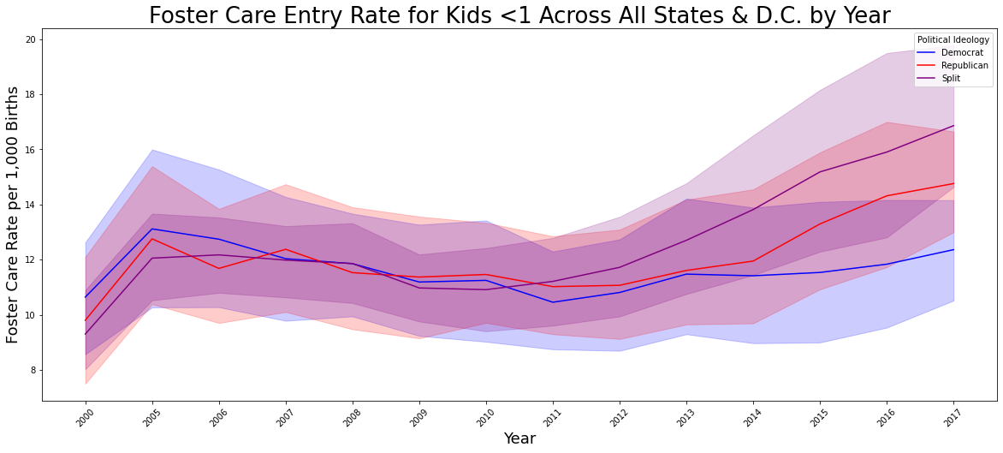
Exploratory Data Analysis
Notes:
Chevaunne
We also wanted to see if we grouped the states according to their political ideology - Democrat, Republican, or Split - whether we see a difference in foster care rates over the same time period. We observed that before 2012, the states seemed to be in tandem, but then we see a sharp increase in entry rates among the split and republican states, while the democrat states experience a less noticeable increase. And now, Ange will review our Tableau dashboard. Take it away Ange!

Slide 11
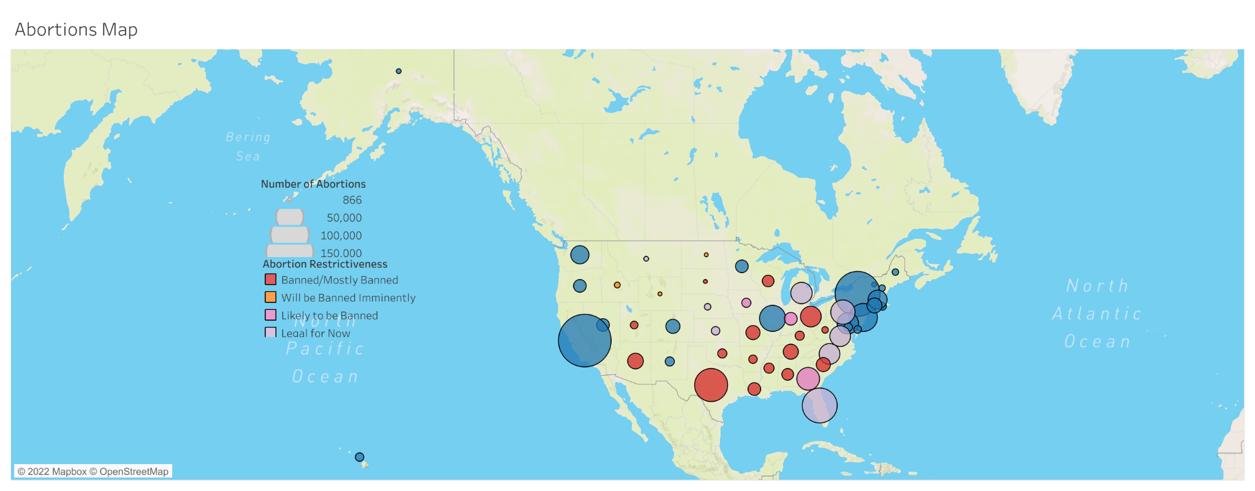
Interactive Tableau Dashboard
Notes:
Ange: go to the dashboard website (the title of the slide is a link) and just go over the plots & what they are very briefly - pick a few states to showcase the exploratory findings

Slide 12
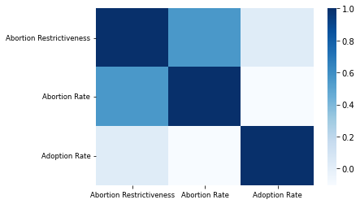
Analysis
Correlation Analysis:
Abortion restrictiveness is highly related to political ideology
⍴=0.75
Abortion restrictiveness and (legal) abortion rate have a negative relationship
⍴=-0.56
But, there is little to no relationship between abortion restrictiveness and adoption rate
⍴=-0.03
Notes:
Sasha
As the laws become more restrictive the number of abortions decreases, but this is not the case with the number of adoptions.

Slide 13
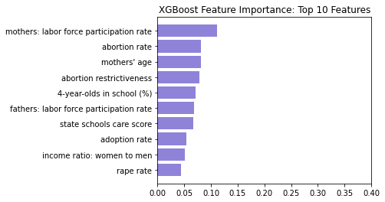
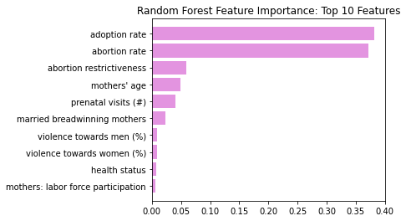
Models
Models used for finding important features:
Random Forest
XGBoost
Tree-based methods
Rank variables based on how they “improve” predictions
Notes:
Sasha
As the laws become more restrictive the number of abortions decreases, but this is not the case with the number of adoptions.

Slide 14
Results & Findings
How do restrictive abortion laws impact rates of abortion, foster care entry, and adoption?
As the abortion laws become more restrictive…
Rate of (legal) abortions decreases
Rate at which infants enter foster care increases
Rate of adoptions decreases
What factors influence the rate of entry into foster care?
Abortion rate
Number of prenatal visits & health status of pregnant women
Abortion restrictiveness
Mothers’ labor force participation rate
Notes:
Sasha
Important features include abortion rate, the number of prenatal visits & health of the pregnant woman, abortion restrictiveness, and the Mothers’ labor force participation rate

Slide 15
Thank You!
Any Questions?
Notes:
Sasha

Slide 16



Context
The Context

